Slide 1

GIS for Geoscientists Session 1: Why GIS?
Image Credit: Patrick Kennelly, Montana Bureau of Mines and Geology
Presented by Nicholas Barber, 4th Year PhD Student at the University of Cambridge, U.K.
ndb38@cam.ac.uk | www.volcannick.com | https://github.com/ndb38 | Twitter @volcannick

Slide 2
Why GIS?
Motivations for the strapped-for-time earth scientist

Slide 3
Four reasons to use GIS
Job Prospects
Advancing your analysis
Making your data reusable
Story telling

Slide 4
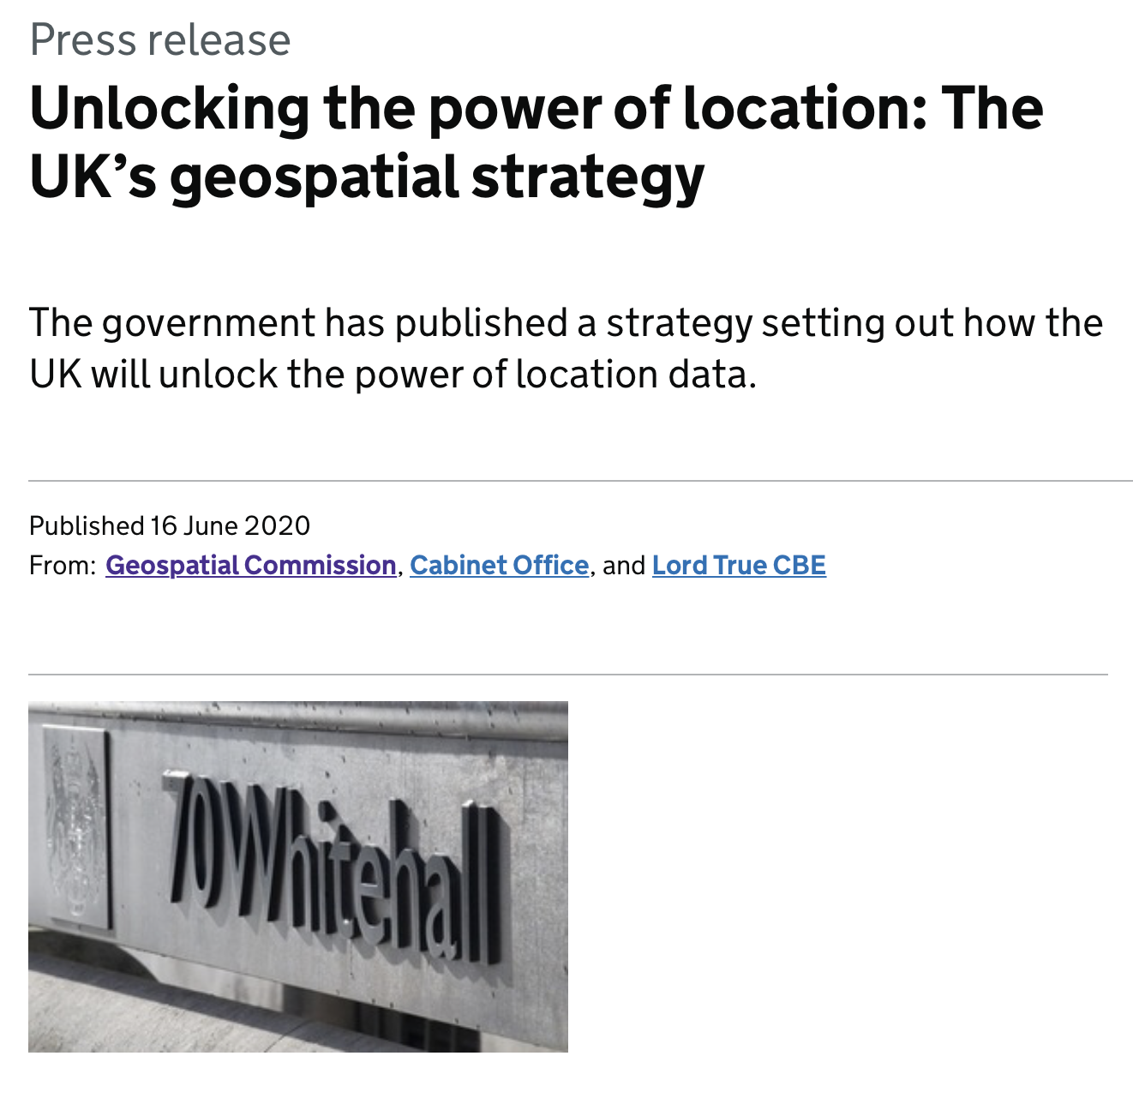
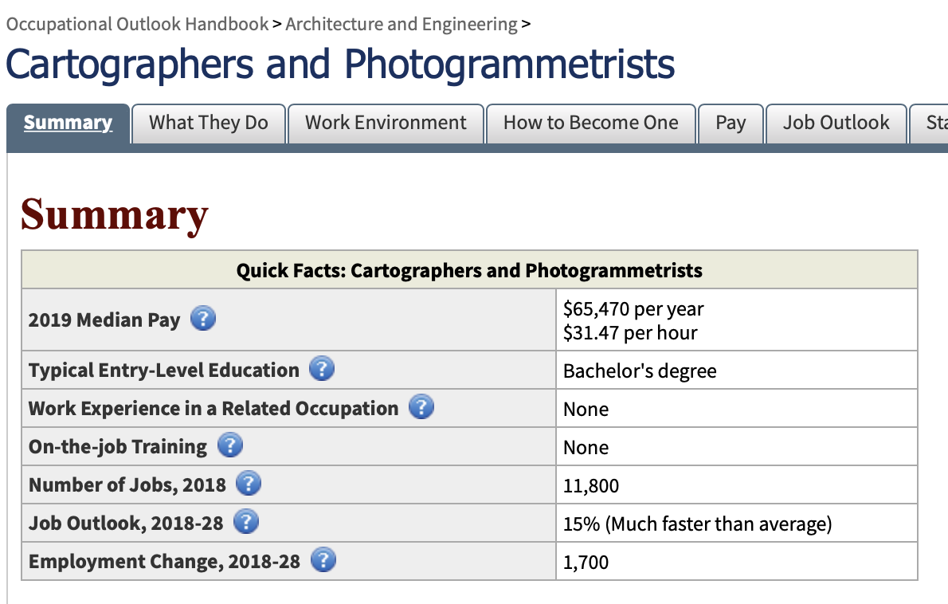
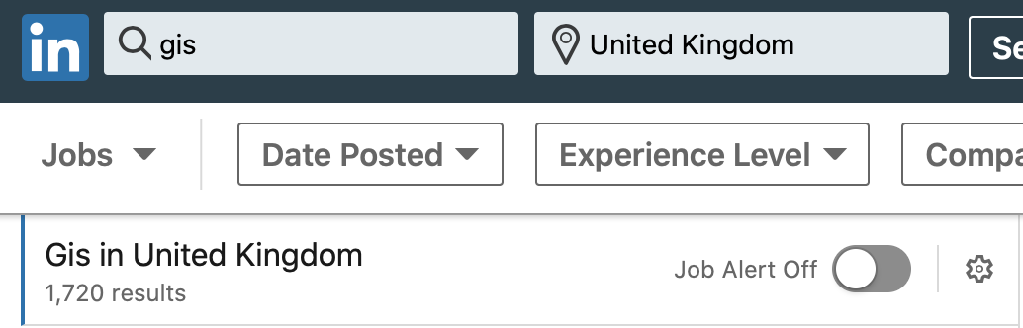
Job Prospects
Geospatial industry projected to grow to a value of $19 billion USD by 2024
Compound annual growth rate (CAGR) of over 10%
Geospatial industry targeted as a key area of growth by UK government
Notes:
Employment for GIS specialists outstripping average employment growth
Geological Society of London highlights GIS alongside drawing software and programming skills as essential skills in careers for geologists

Slide 5
Job Prospects
Learning how to properly use GIS takes time and patience. That translates to value for any employer (academic private, public)
Positioning yourself as a geologist with GIS awareness increases your utility in any organization

Slide 6
Advancing your analysis
Economic Geology:
Determining cost/environmental impact of a new mine (water resources, accessibility, topography, water table, population centers, municipal boundaries)
Volcanology
Mapping risk posed by different eruption scenarios
Environmental Geology
Modeling the risk posed by a pollutant at a great distance from pollution source
Sedimentology
Mapping known outcrops to determine where the same formation will appear outside study area
Geophysics + Structural geology
Integrate stress models and seismic focal mechanisms with known geology + chemistry
Public Policy, Infrastructure, Conservation, COVID Tracking, App Usage….

Slide 7
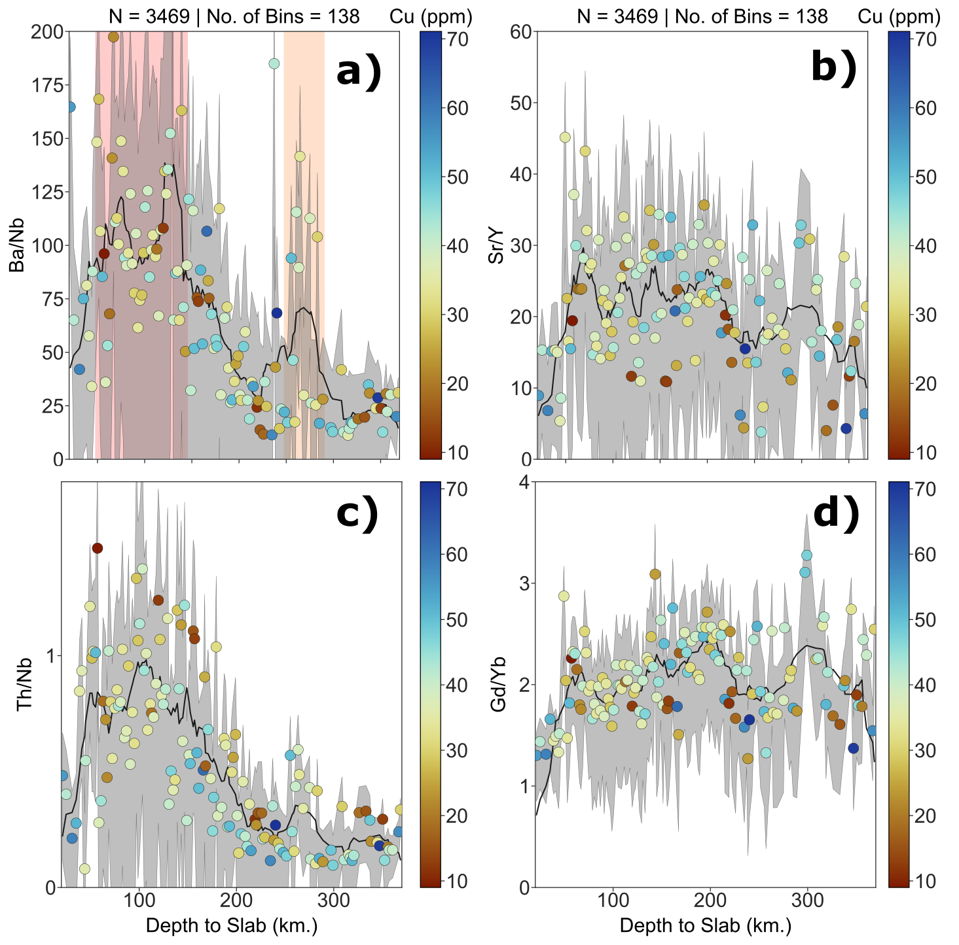
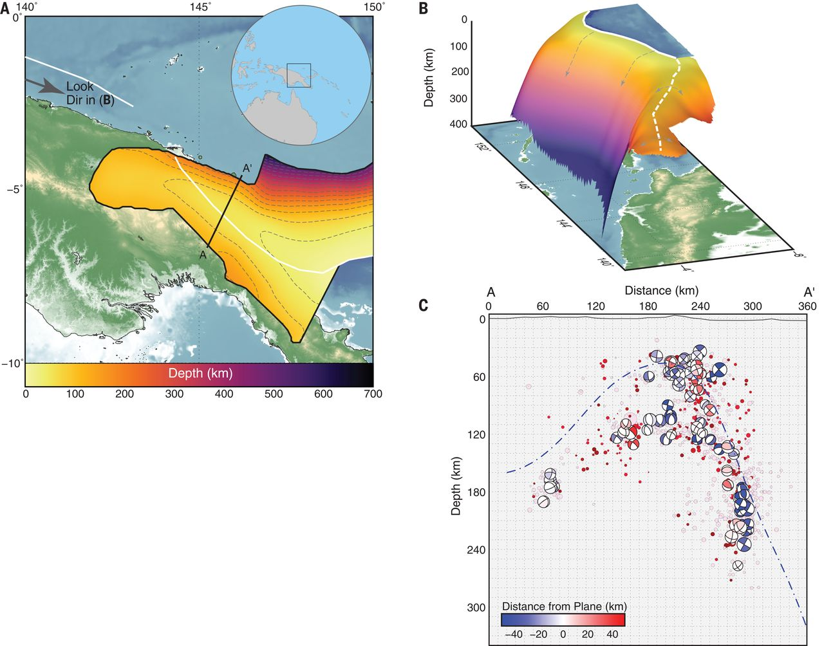
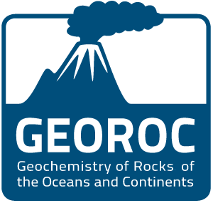
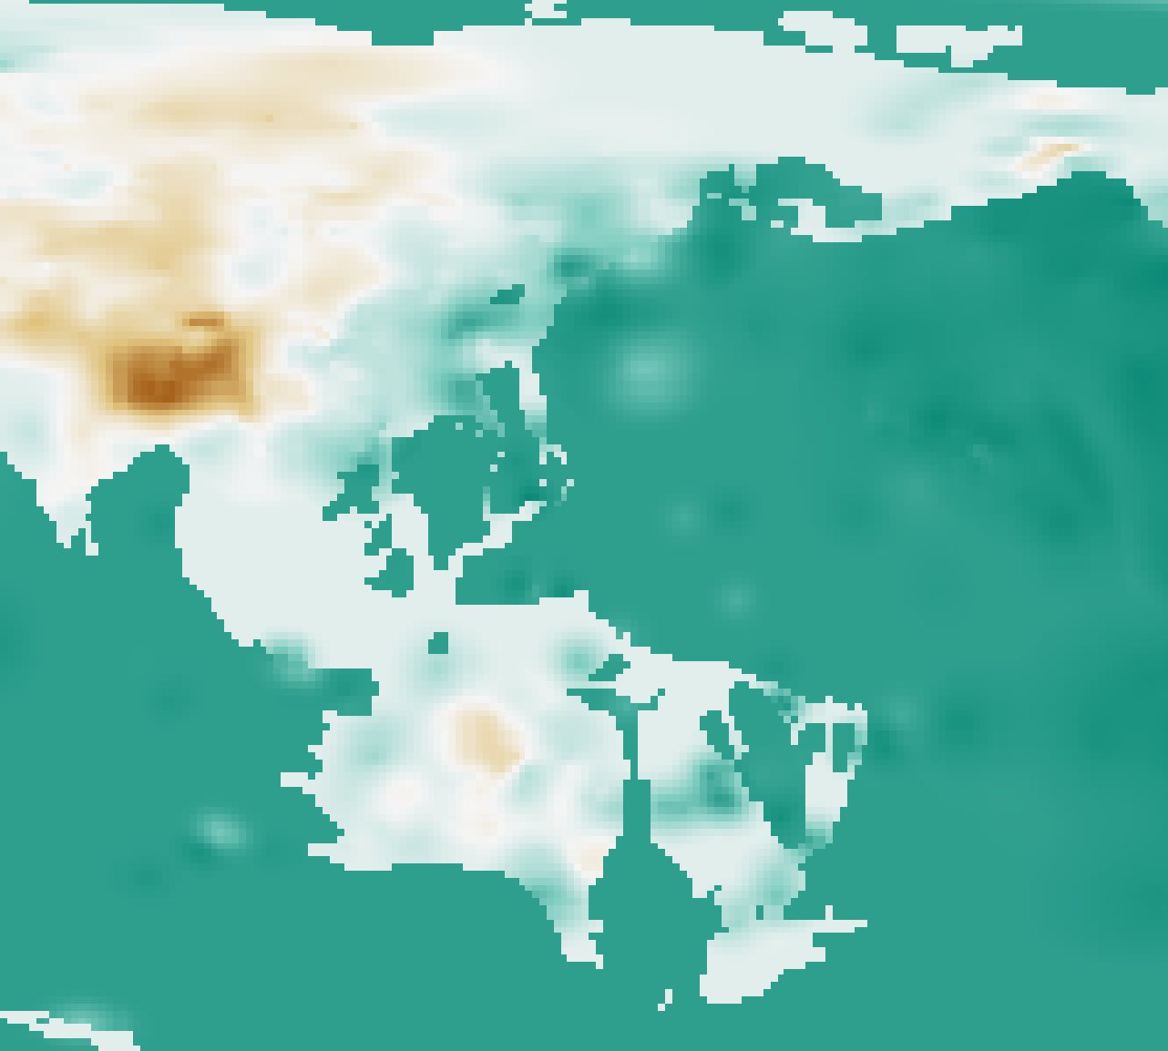
Example: ArcMetals Database
Data sources: GEOROC, Hayes et al. 2018 (Science), Szwilllus et al. 2019 (JGR). ArcMetals: Barber et al. 2021 (GCA)

Slide 8
Making Data Reusable
As earth scientists, everything we do is spatial
Open Data and Data Reproducibility one of the biggest concerns/frontiers in science today
If you aren’t building spatial metadata/analyses into your workflow, your work isn’t reproducible by other earth scientists!

Slide 9
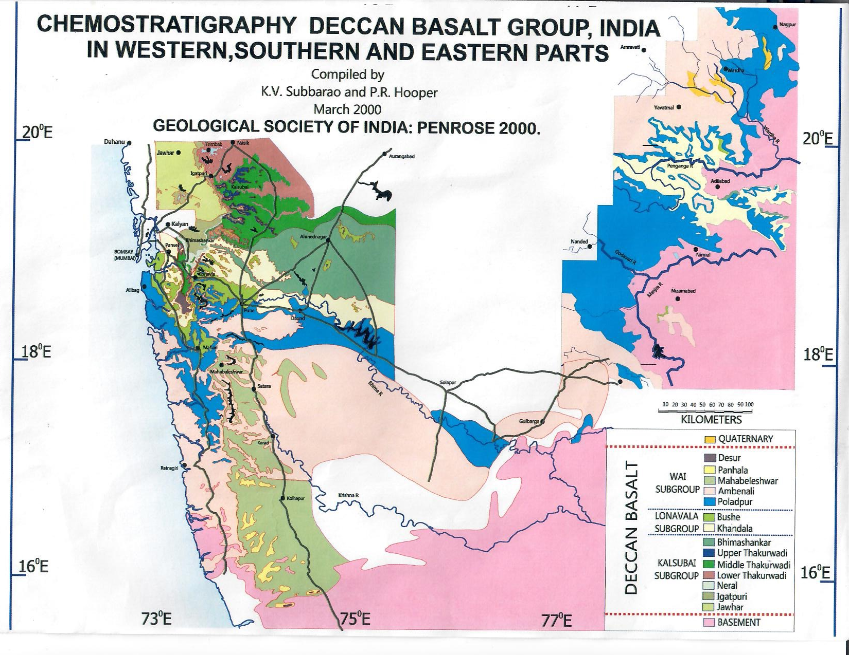
Example: Stratigraphy of the Deccan Traps

Slide 10
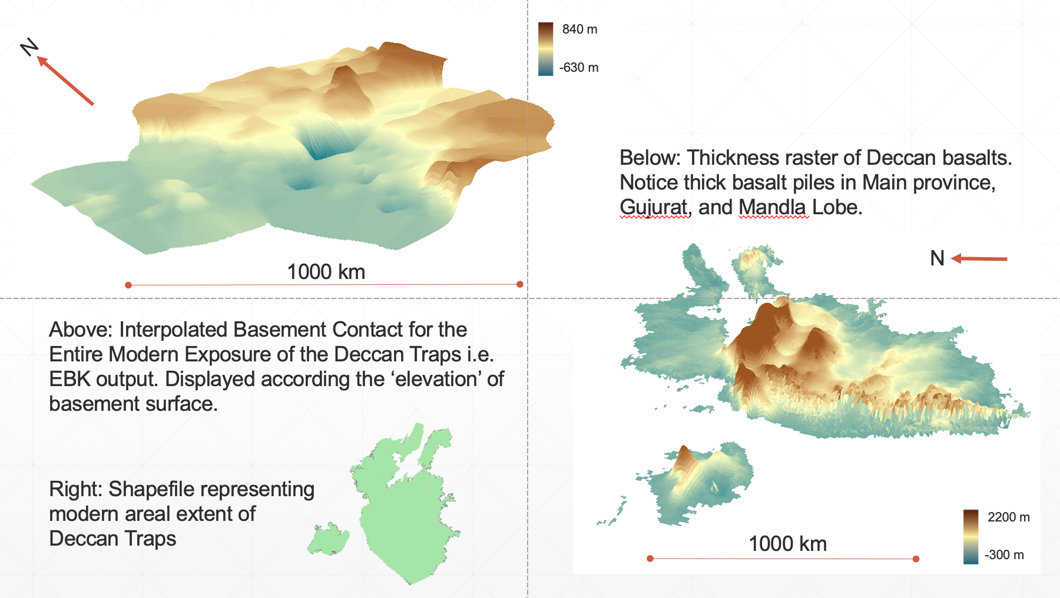
Example: Stratigraphy of the Deccan Traps

Slide 11
Story Telling + Communication
Underlying link of our data to the wider world makes for compelling stories
Integrating GIS into your research lets you tell stories rooted in place, time, and culture
Story Maps from ESRI:
ESRI (ArcGIS) has developed digital story telling format the leverages this capacity
Alternative way to present your research
Let the maps tell your story

Slide 12
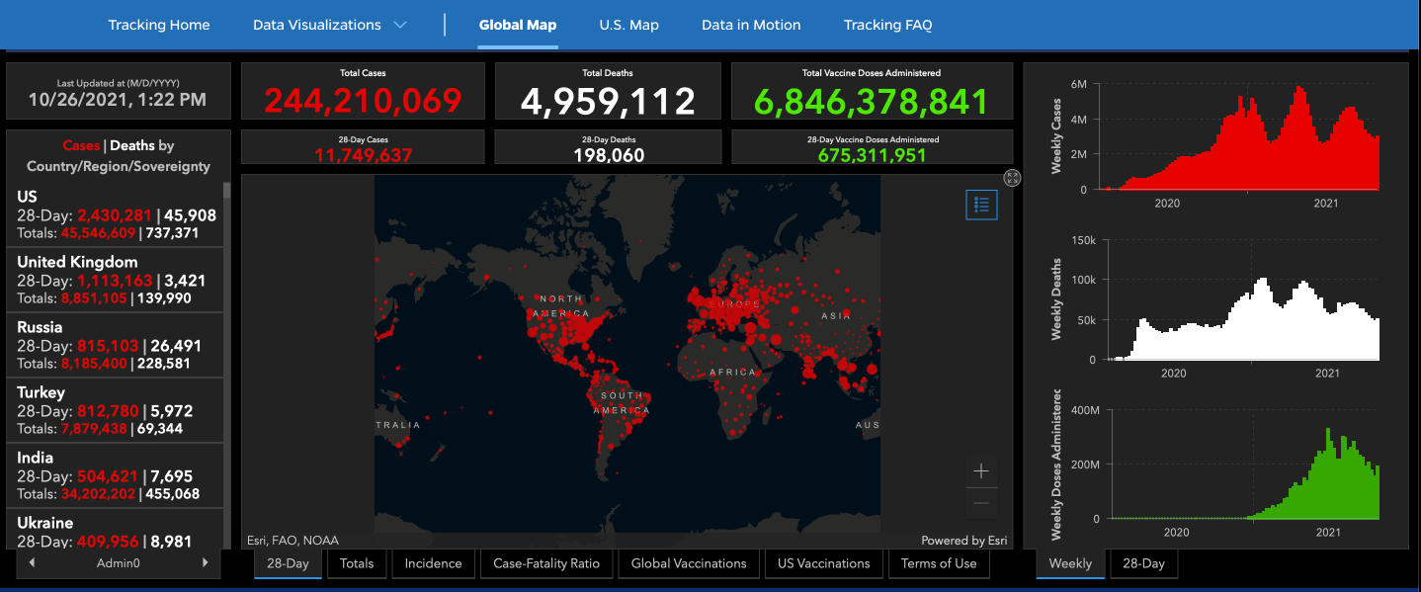
Johns Hopkins University GIS Dashboard

Slide 13
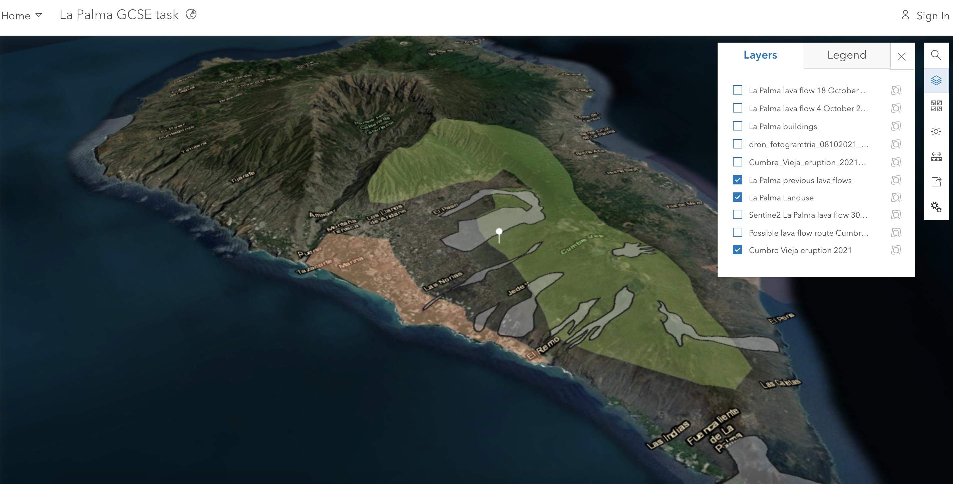
https://arcg.is/190fG80

